Slide 1
CAlifornia’s
System for
Pesticide
Incident
Reporting

Slide 2
– Agenda
Introduction
CASPIR Overview
End – to – End Demo
Playtime

Slide 3
– Getting Started
.com
Website at http:// app.org
.net
Documentation at
http://calicosol.com/caspir-documentation

Slide 4
– The Purpose
Establish better rapport between
Counties/DPR
and
Fieldworker Organizations

Slide 5
: Timeline
2016: Brainstorming Sessions w/ George Farnsworth
2016 – 2018: Countless Meetings with DPR, CalEPA, EPA Region 9
March 2018: Project Start
Sept 2018: Code Complete
Nov 2018: First Stakeholder Meeting
Jan 2019: More Stakeholder Meetings
Jan 17, 2019: App Store Submittals

Slide 6
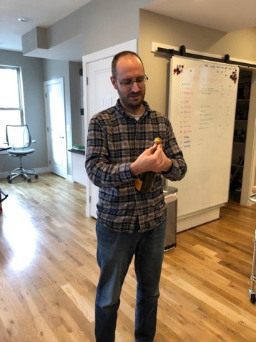
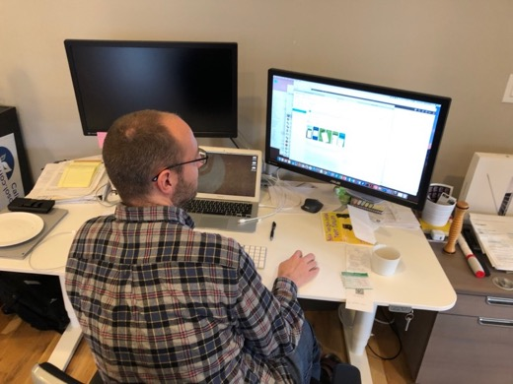
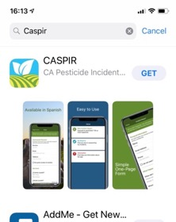
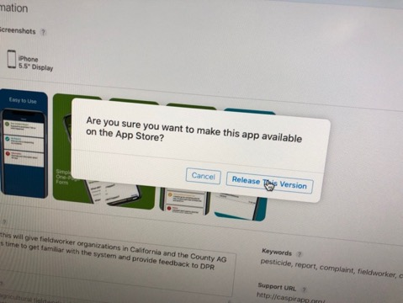
: Timeline
Jan 22, 2019: Apps are LIVE!!!!!!

Slide 7
: Timeline
Jan 24, 2019: CAPEG Meeting
Jan 24, 2019: First Test Incident Report by County (Imperial County 2019-0036)
Feb 2019: Training Sessions
Feb 2019: Soft Launch
2019: Fieldworker Groups Outreach Sessions
2019: Official Launch

Slide 8
– Overview
Submit Incident Report
A Place

Slide 9
– Overview
Submit Incident Report
Intelligent Case Router
The Right Place

Slide 10
– Overview
Mobile App
Intelligent Case Router
CASPIR Admin Portal
CalPEATS Incident Report
Investigation

Slide 11
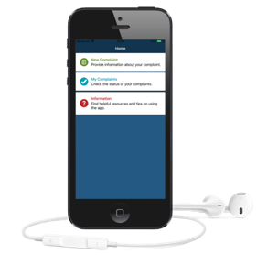
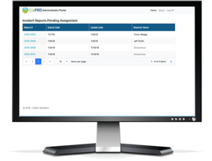
– Overview
CASPIR
Mobile App
CASPIR
Administration
County
Investigation

Slide 12
– Overview
for Fieldworkers
Submit pesticide related incidents
Free download
CASPIR
Mobile App
CASPIR
Administration
County
Investigation

Slide 13
– Overview
for DPR
http://caspirapp.org
Automatically forwards reports
Manually assign reports
CASPIR
Mobile App
CASPIR
Administration
County
Investigation

Slide 14
– Overview
for County Staff
CalPEATS
Permission driven
Familiar Investigation
Export for non-pesticide
Limited communication
CASPIR
Mobile App
CASPIR
Administration
County
Investigation

Slide 15
– Overview
for Fieldworkers
submit pesticide related incidents
Free download
for DPR
http://caspirapp.org
Manually assign reports
for County Staff
CalPEATS
Permission driven
Familiar Investigation
Export for non-pesticide
Limited communication
CASPIR
Mobile App
CASPIR
Administration
County
Investigation

Slide 16
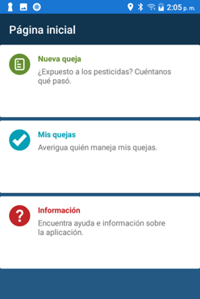
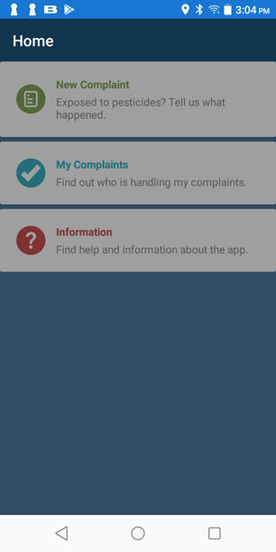
: Mobile
1
iOS & Android
Free on App Stores
Simple and effective
Multilingual
Offline mode
Limited to pesticide-related Incident Reports
Communication possible but not in real-time (non-emergencies)

Slide 17
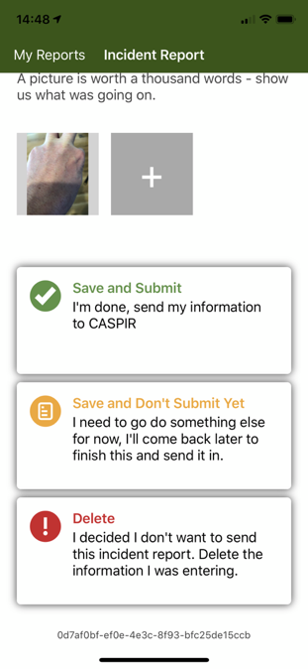
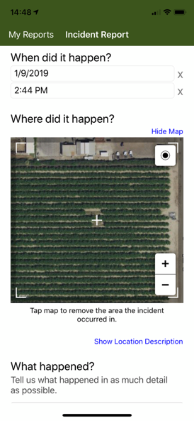
: Mobile
1

Slide 18
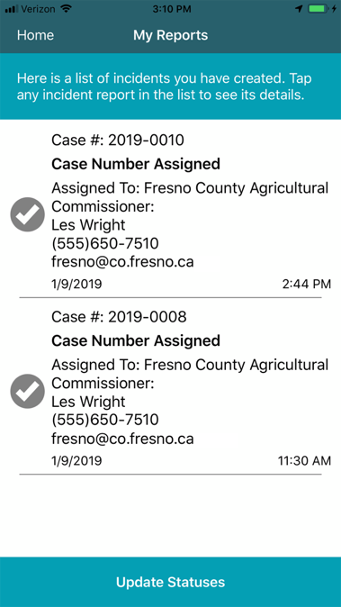
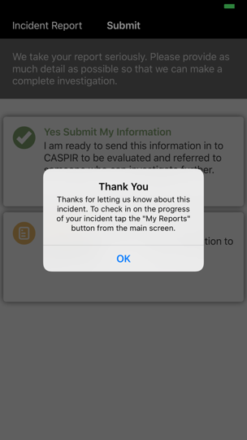
: Mobile
1

Slide 19
: Admin Web Portal
2
Query for Incident Reports
See Incident Report status
See Incident Report details
Functionality to route Incident Reports to correct location

Slide 20
: Admin Web Portal
2

Slide 21
: Admin Web Portal
2

Slide 22
: Admin Web Portal
2

Slide 23
: CalPEATS
3
CalPEATS enhanced to deal with Incident Reports
New permissions to view/edit Incident Reports
New Search screen
Spawn Investigation from within CalPEATS
Way of dealing with Non-Pesticide Investigations

Slide 24
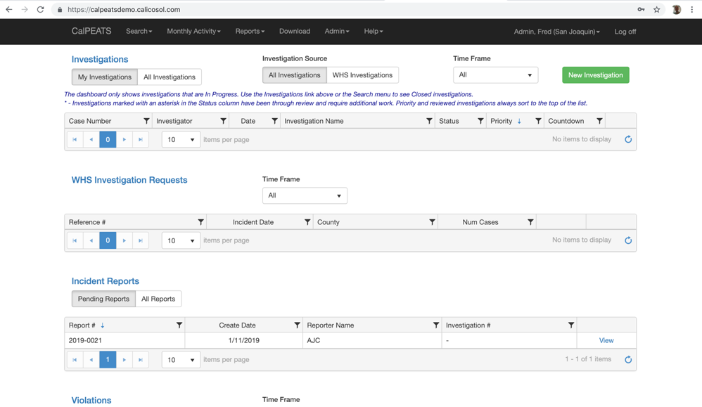
: CalPEATS
3

Slide 25
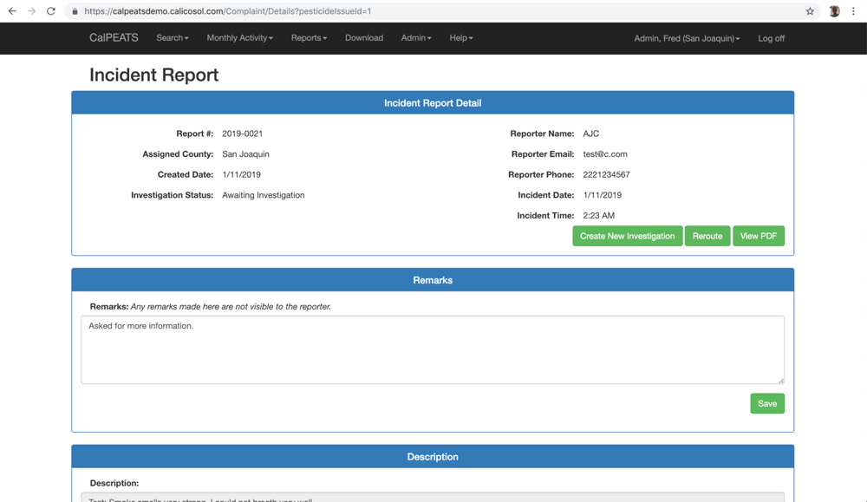
: CalPEATS
3

Slide 26
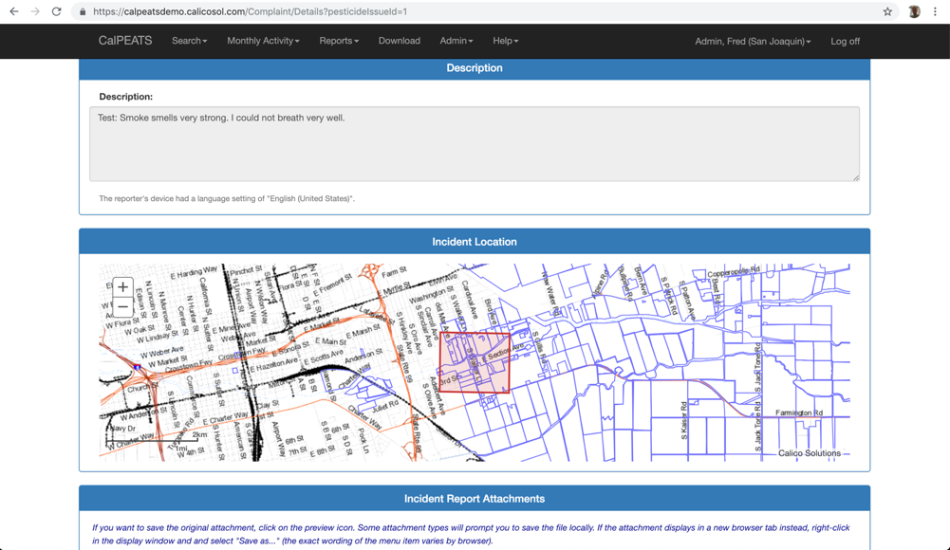
: CalPEATS
3

Slide 27
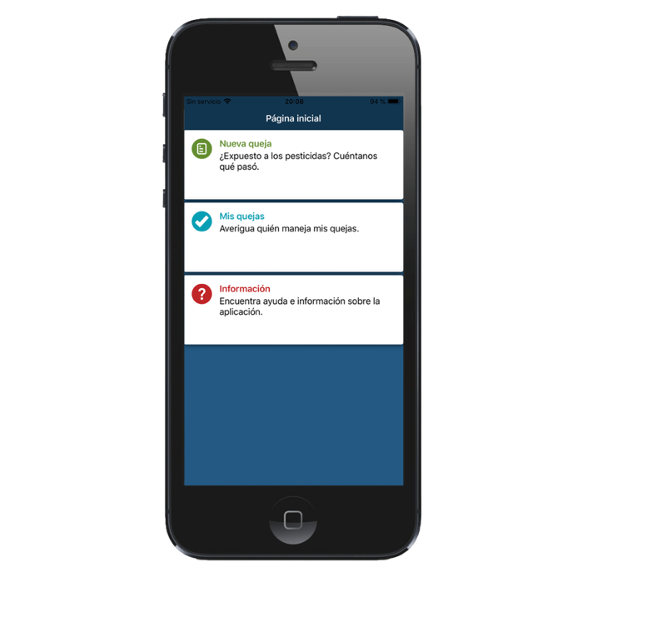
: DEMO

Slide 28
: DEMO
Prepare Mobile App for TEST
Submit Incident Report (Fieldworker)
View Admin Portal (DPR)
CalPEATS (County Staff)

Slide 29
: DEMO
CASPIR Admin Portal
PRODUCTION
CalPEATS
PRODUCTION
(Default)
CASPIR
Mobile App
CASPIR Admin Portal
TEST
CalPEATS
TEST

Slide 30
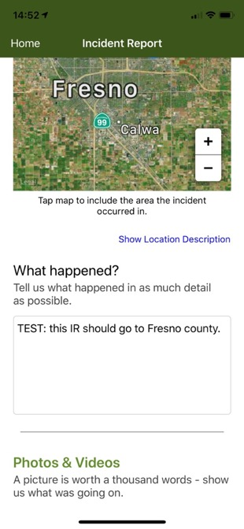
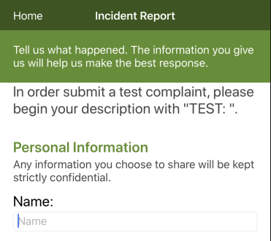
: Submit Test Report

Slide 31
: Stats

Slide 32
: Open Questions
Email Notifications: Who? When?
False Reporting: How many are there?
How do you deal with them?
Deleting Incident Reports: Can counties determine that an incident report should not be investigated by anyone?

Slide 33
– References

Slide 34
: Play Time

